Slide 1







Slide 2






Slide 3




Slide 4









Slide 5



Slide 6






Slide 7












Slide 8
















Slide 9
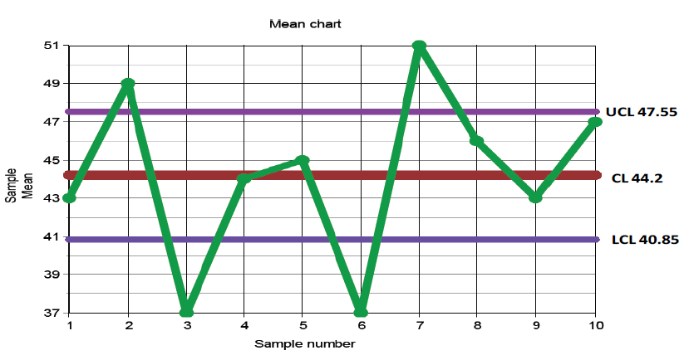


Slide 10
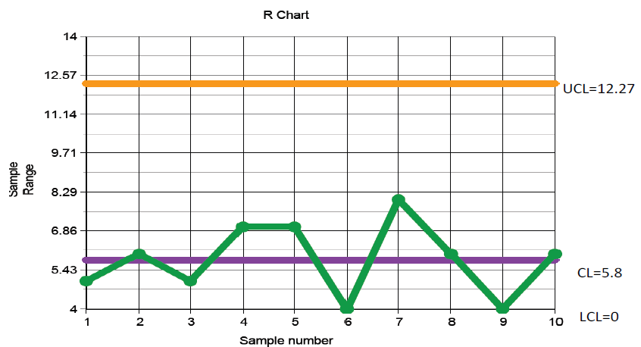

Slide 11
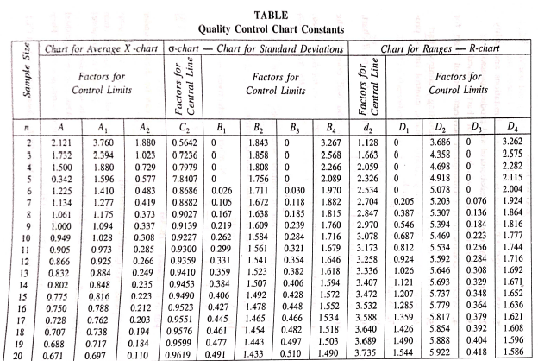

Slide 12




Slide 13



Slide 14






Slide 15





Slide 16












Slide 17
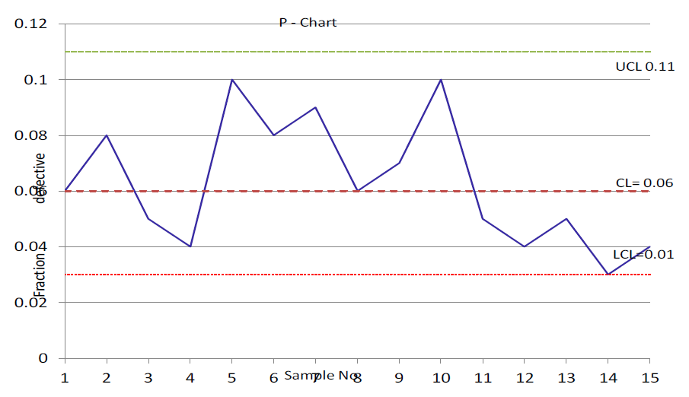


Slide 18






Slide 19











Slide 20
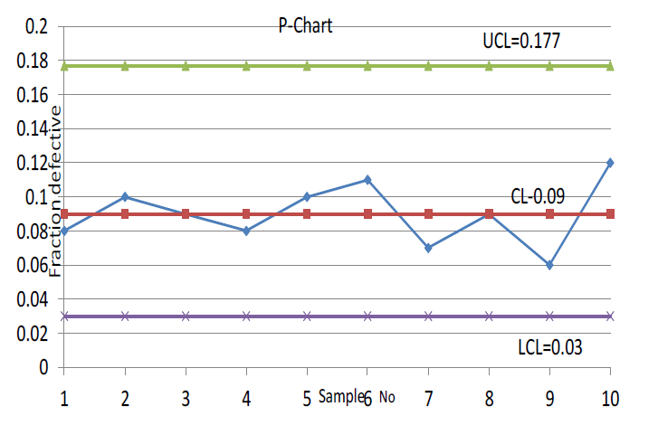


Slide 21







Slide 22





Slide 23






Slide 24
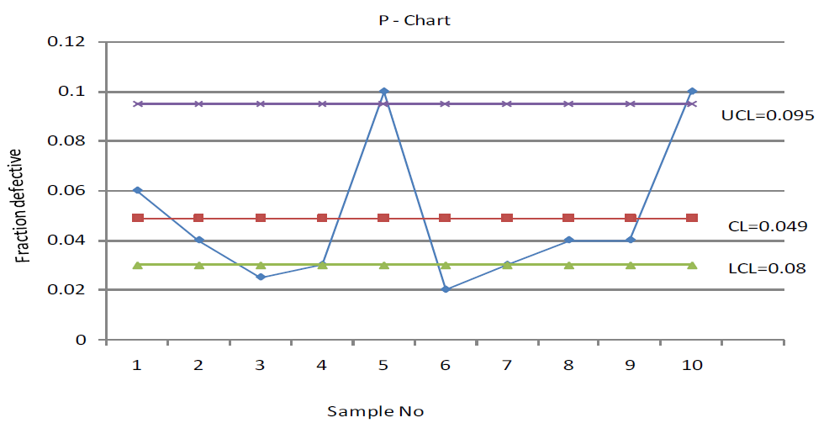


Slide 25







Slide 26








Slide 27
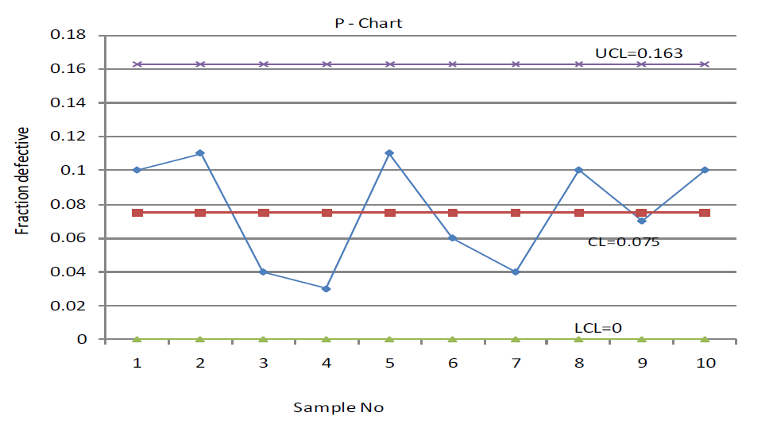

Slide 28



Slide 29







Slide 30






Central line = $n\overline{p}$

Slide 31












$$=14+3\sqrt{14\left(1−0.04\right)}$$

Slide 32


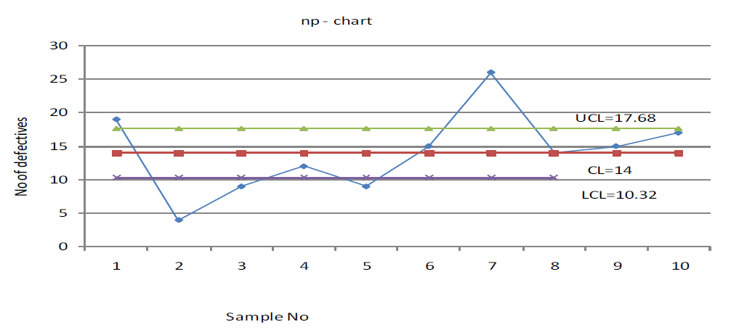


$$=14−3\sqrt{14\left(1−0.04\right)}$$

Slide 33




Slide 34





Slide 35













Slide 36




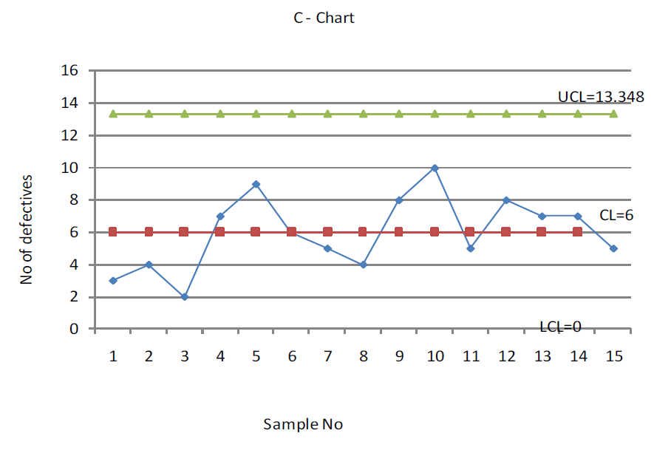


Slide 37










Slide 38
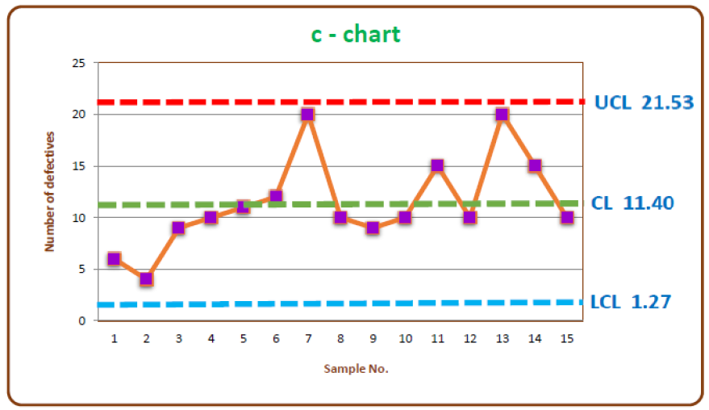


Slide 39



Slide 40






Slide 41




Slide 42





Process Control
Control Charts
Variables
Attributes
$$\overline{X} chart$$
$$R chart$$
$$p− chart$$
$$np− chart$$
$$c− chart$$

Slide 43

















Slide 44








